Slide 1
Series 1 - Laboratory Exercise
Computing Euler's number e three ways: compound interest, the difference quotient, and the exponential series

Slide 2
The Constant e (overview)
e = 2.718281828459045...
  Irrational, transcendental - the base of natural logarithms.
  Appears in growth, calculus, probability and complex analysis.
Three ways to reach it in this lab:
  1. Compound-interest limit (1 + 1/n)^n -> e
  2. Derivative d/dx[a^x] at x=0 = ln(a) via a difference quotient
  3. Exponential Taylor series e^x = sum x^n / n!
Goal: compare convergence speed and the float-precision limit.

Slide 3
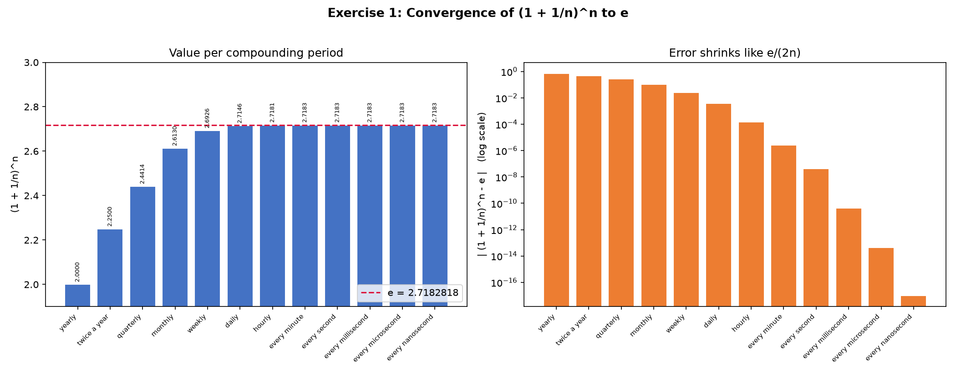
Exercise 1 - (1 + 1/n)^n -> e
Concept
  Compound a 100% rate n times per year: factor = (1 + 1/n)^n.
  As n grows (yearly -> every nanosecond) the factor -> e.
Answer / Result
  yearly n=1 -> 2.0000 ; daily n=365 -> 2.7146
  by every second it is stable to 7 decimals (2.718282).
  Error falls like e/(2n): doubling n roughly halves the error.
Numerical trick
  Use exp(n*log1p(1/n)); the naive form rounds to 1.0 for n >= 1e16.

Slide 4
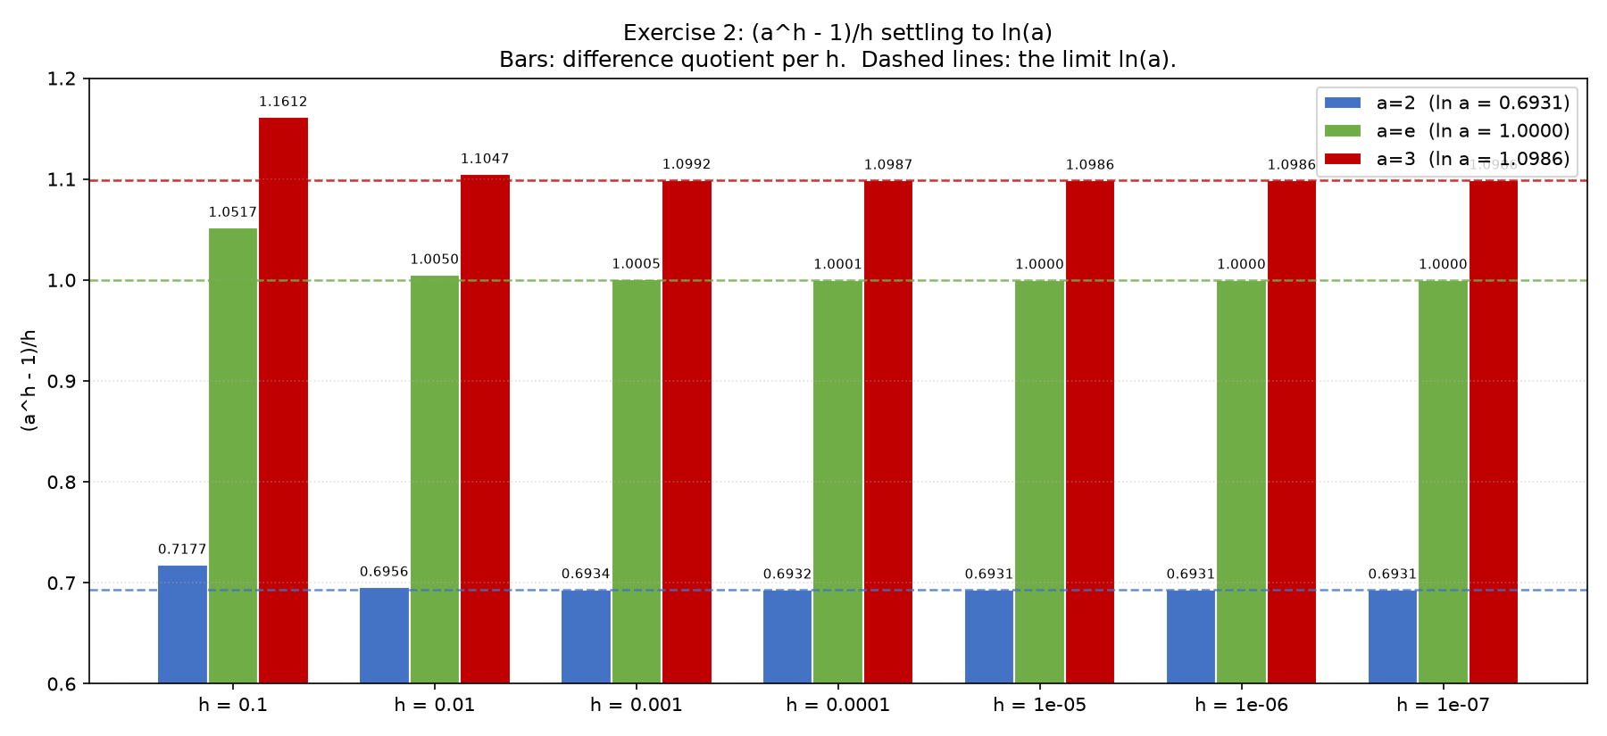
Exercise 2 - (a^h - 1)/h -> ln(a)
Concept
  This is the derivative of a^x at x = 0, i.e. ln(a).
  The forward difference quotient is a finite-step estimate of it.
Answer / Result
  a=2 settles at 0.6931 (ln 2)
  a=e settles at 1.0000 (ln e = 1, the 'natural' base)
  a=3 settles at 1.0986 (ln 3)
  Truncation error is O(h): each 10x smaller h adds ~1 digit.
Numerical trick
  Use expm1(h*ln(a))/h to avoid catastrophic cancellation.

Slide 5
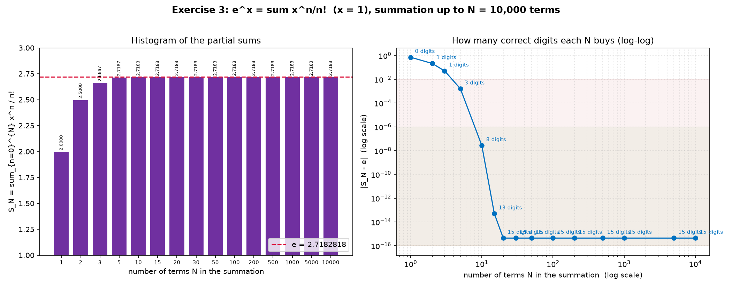
Exercise 3 - e^x = sum x^n / n!
Concept
  Maclaurin series of exp(x); for x=1 it gives the series for e.
  Terms 1/n! vanish super fast, so convergence is super-linear.
Answer / Result
  N=10 -> ~8 correct digits ; N=15 -> ~13 ; N=20 -> full double precision.
  Beyond N~20 the error is frozen at the machine floor 4.44e-16.
  Summing to N=10,000 gives the same result as N=20.
Why it flattens
  Once 1/n! < machine epsilon (~2.2e-16) extra terms change nothing.

Slide 6
Comparison & Conclusion
Three routes to e, three convergence speeds:
  Ex.1 (1+1/n)^n : O(1/n) - needs n ~ 1e15 for 15 digits (slowest)
  Ex.2 (a^h-1)/h : O(h) / decade- needs h ~ 1e-15; hits cancellation limit
  Ex.3 sum x^n/n! : super-linear - only ~20 terms for full precision (fastest)
Conclusion
  The Taylor series is the most efficient; it is what computers use for exp(x).
  The limits (Ex.1, Ex.2) converge too slowly for practical computation.
  Numerically-stable formulas (log1p, expm1) are essential near the precision limit.

